Slide 1
Smart Travel App
Building a Smart Traveler Community

Slide 2
Business Objectives
To promote a variety of transport options, based on: shortest distance, fastest route, type of transport and disability friendliness.

Slide 3
Features
Public website and app introduction
Travel assistance, with the following steps:
tell your current location
tell your destination
tell your preferred choice of travel: by shortest time, fastest route, type of transport, and disability friendliness.
system will recommend few options: public bus, public train, private hire bus (shuttle bus), public registered taxi, online taxi (such as Grab, Uber), shared bicycle, or even walk
choose your preferred mode
system will show the details of travel, for example: what time to catch bus, from which bus stop, how to get there, total cost, etc.
Register to become a member
For member: save travel as favourite, see travel history, buy ticket, travel booking
For admin: Administrative functions, like users management, etc

Slide 4
Differentiator
What makes our app special? Here are few killer features which differentiate us with followers / others:
Integration with external transport providers
One single to manage my transport, which includes my travel history, ticket purchase, and booking
Recommendation engine

Slide 5
Tech Stack
Web FrontEnd: ReactJS
Mobile Web: ReactJS
API gateway: AWS API Gateway
Backend microservices: AWS Lambda
Database: AWS RDS
Files repository: AWS S3
User authentication: AWS Cognito
CDN: AWS CloudFront
Web application hosting: AWS S3
Logging: AWS CloudWatch
Recommendation engine: AWS SageMaker

Slide 6
Team Member
Rups: Sr. big data engineer / architect
Fernando: AWS full-stack developer / architect
Ian Goh: Python Django developer
Ishan: React, Java, Python developer
We are experienced in full-task AWS services, comprises of compute engine (EC2, beanstalk, Lambda), storage (S2), database (RDS, Aurora), API gateway, Machine learning and big data (Sagemaker), etc

Slide 7
Code Repository
Code repository: https://github.com/fernandokarnagi/smarttravel
Demo: http://smarttravel-app.com.s3-website-ap-southeast-1.amazonaws.com/

Slide 8
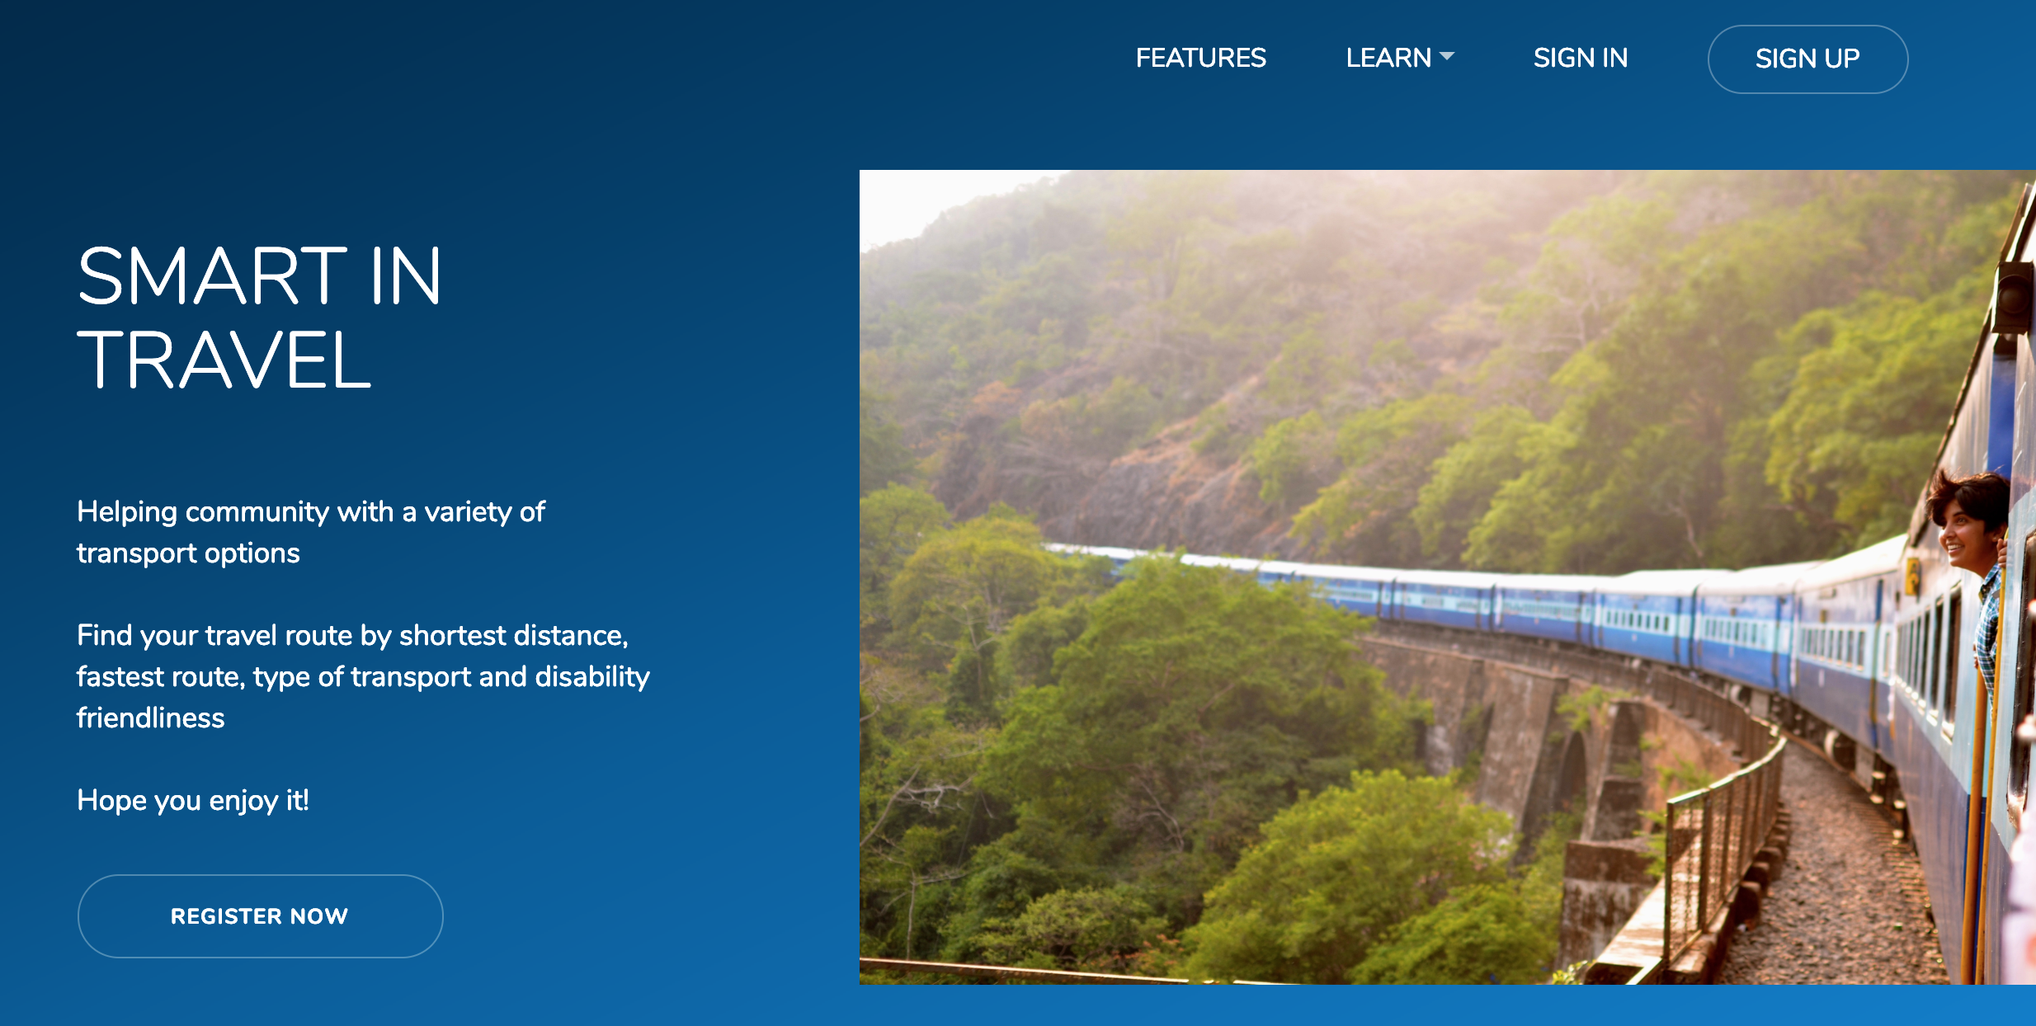
Public website

Slide 9
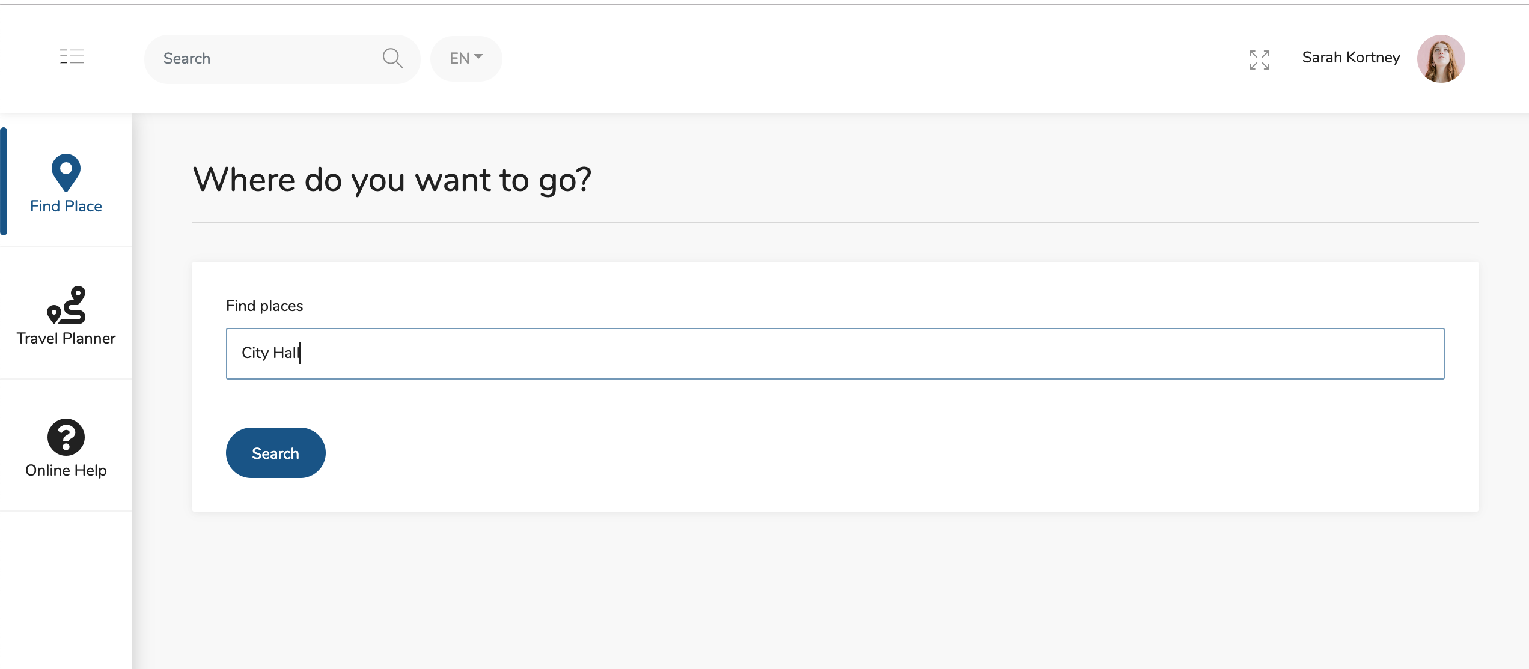
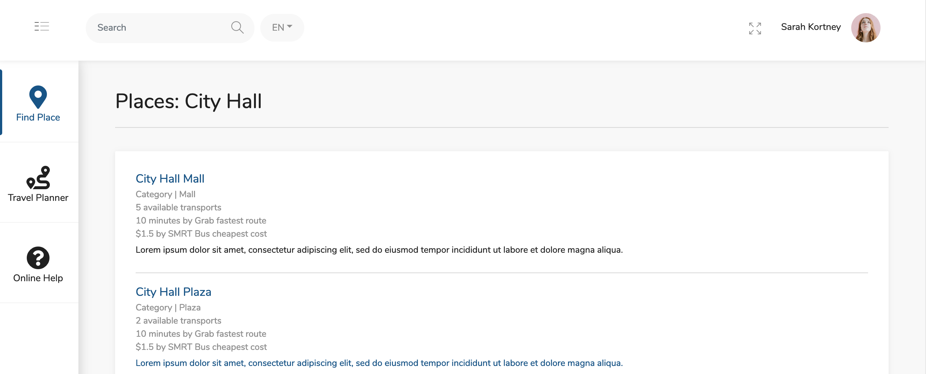
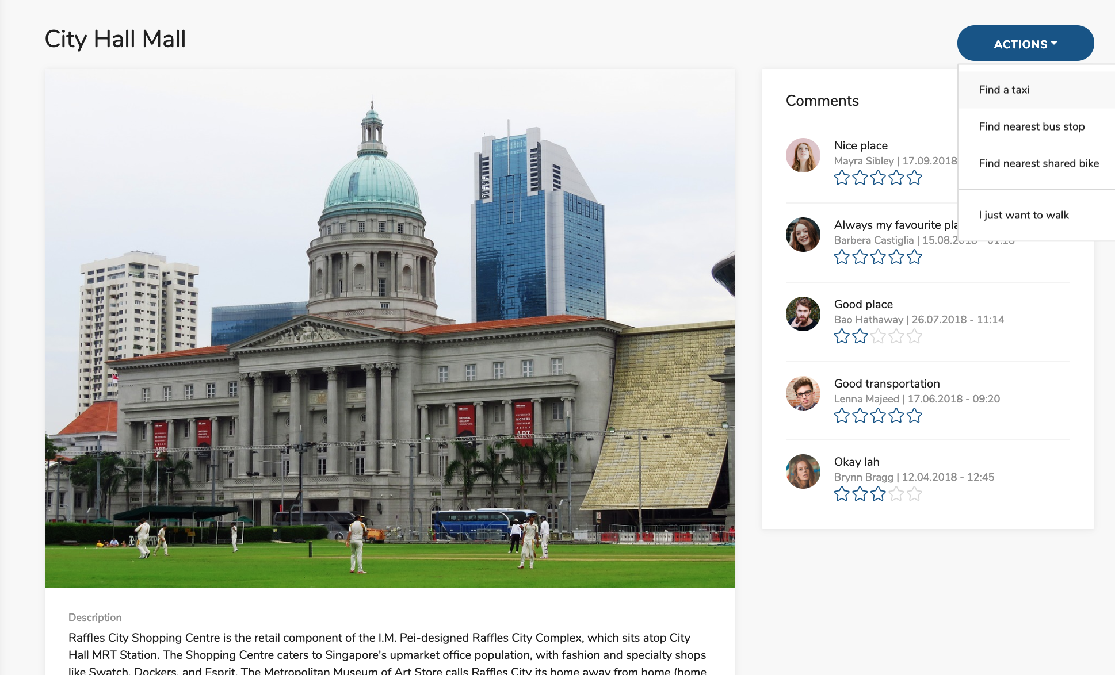
Easy Place Finder

Slide 10
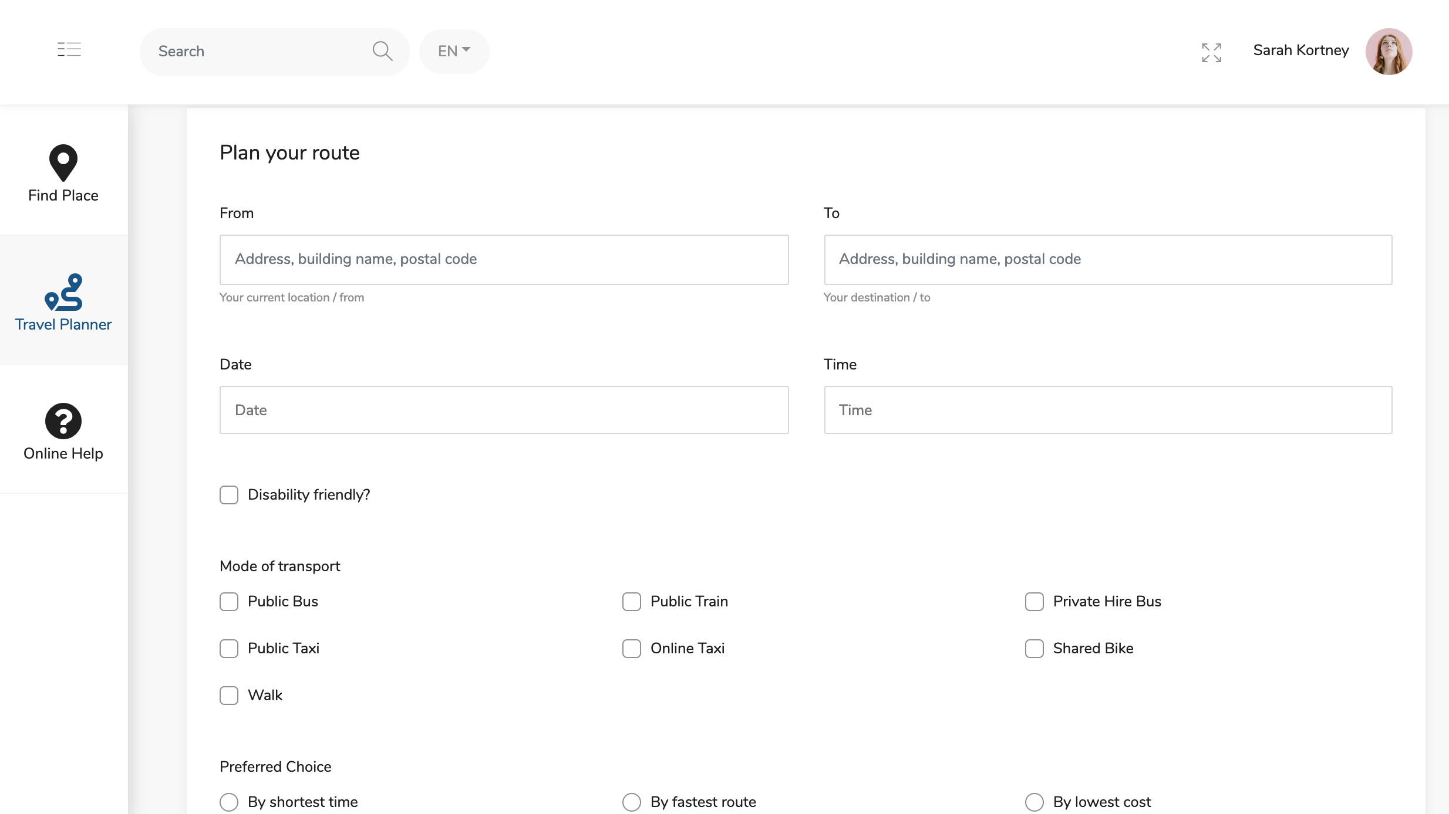
Plan your route

